Slide 1
Developing Reading Competencies at Different Levels
Critical Reading for Students at the Undergraduate Level
DR PYNSUKLIN SYIEMIONG
DEPT OF ENGLISH SANKARDEV COLLEGE, SHILLONG

Slide 2
Introduction
Reading is not just about recognizing words; it also requires understanding, critical thinking, and the ability to make connections between what is read and prior knowledge or experiences
Reading is a foundational skill that plays a crucial role in learning, communication, and personal development
It involves decoding symbols (letters and words) to derive meaning, comprehend text, and interpret ideas or information

Slide 3
Why Reading is Important
Cognitive Development
Reading stimulates the brain, enhancing memory, concentration, and analytical skills
Communication
It allows for better written and spoken communication, as reading exposes people to a variety of expressions, sentence structures, and ideas
Lifelong Learning
Reading equips individuals to continuously learn, explore new subjects, and stay informed about the world
Empathy and Understanding
Through reading, especially literature, individuals can experience diverse perspectives and cultures, enhancing empathy and global awareness

Slide 4
Key Aspects of Reading
Decoding
Translating written words into sounds for better understanding
Comprehension
Understanding both the literal and deeper meanings of texts
Fluency
Reading smoothly to enhance focus on meaning rather than word recognition
Vocabulary
Encountering new words, building language skills, improving ability to grasp more complex material
Critical Thinking
Questioning, analyzing, and evaluating what is read, and then making a judgment about it
Engagement and Interpretation
The act of actively participating in reading activities and the process of understanding the meaning of a text

Slide 5
Critical Reading : Meghalaya Context
The English Curriculum as envisaged by the NEP 2020 has in its purview a curriculum that would cater to the needs of the students’ varied interest
Our focus : Understanding critical reading to suit the interest of students at the undergraduate level (3rd Semester, AEC, FYUG)
Major and Minor in English along with
genres of English within the SEC, AEC and MDC courses
Exposure for students to the plethora of genres that lay within the folds of learning English
Reading has emerged as a skill that forms the basis for sound learning

Slide 6
Aspects of Critical Reading for Students at the Undergraduate Level in Meghalaya
1. Readers create meaning from every text through close reading
2. Critical readers interact with the texts they read by questioning them, responding to them and expanding them, usually through writing
3. To create meaning, critical readers use a variety of approaches, strategies, and techniques which also include the application of their personal experiences and existing knowledge to the reading process
4. Critical readers actively refer to other texts, related to the topic of their investigation

Slide 7
1. Readers create meaning from every text through close reading
Reading is not supposed to be a passive skill
When we read, we ‘consume’ texts, when we write, we ‘produce texts’
When we produce texts, reading becomes an active and energetic process of making new meaning and new knowledge
Critical readers interact with the texts they read through carefully listening, writing, conversing and questioning – working hard in order to create such meaning .
Critical reading allows readers to create new ideas from what is read to become independent and creative learners
Every one reads – in one way or another
Good writing is usually based or influenced by ideas, theories and stories that come from reading
Writers who do not read have little to say to others

Slide 8
Critical reading is a collaboration between the reader and the writer – allowing for the construction of meaning of every text that is read
Critical readers do not read alone and in silence – meaning they take notes and write about what they read. They also discuss the texts with others and compare ideas and interpretations
Reading for information and trying to extract the main points OR reading in silence without exchanging ideas with others does not mean that one is talking back to the text and questioning it nor extending one’s knowledge
Critical readers are not made overnight (takes a lot of practice and patience)

Slide 9
2. Critical readers interact with the texts they read by questioning them, responding to them, and expanding them, usually through writing
Critical reading is a two-way process between the text and the reader (talking to the text, questioning every factor or idea, expanding in writing by adding own personal understanding and experiences)
Text present ideas, not absolute truths. No text, no matter how well written and authoritative can have a pre-determined meaning. We must question the authority of the printed page. Years of schooling have made us believe that on-paper text present absolute truths
Not even the best researched and written definitive text is absolutely complete and finished. These are always subjected to questioning and interpretations with the passage of time.
The way we believe or disbelieve certain texts clearly varies from one individual to the text. Critical readers understand that the same text will have different meanings for different people. This is acceptable for it reflects features of a strong, engaging and enjoyable reading process

Slide 10
Reading and interpreting texts as well as sharing one’s views with others are rhetorical acts. To either persuade or be persuaded
Critical readers know the difference between reacting and responding to a text
Reacting is done in an emotional mode, rather than at the intellectual level. It is quick and shallow
Responding to a text requires a careful study on the ideas presented and arguments advanced in it and not just simply accept or reject it after the first reading
Critiquing a text however does not mean to criticize but to analyze it in a logical and objective manner
It is only when one engages in such a dialogue with the text that one can expand it in writing

Slide 11
3. To create meaning, critical readers use a variety of approaches, strategies, and techniques which also include the application of their personal experiences and existing knowledge to the reading process
Underline words, sentences, key arguments and passages that stand out
Take notes on the margins or attach post it notes along with the text (this is the stage of active reading and deriving meaning). Writing extended responses about what one reads is the best way to make sense of it.
In the comments, ask questions, agree/disagree with the author, question the text, offer counter arguments and examples, mention personal experiences
Write exploratory (investigative) responses in order to understand the text at a deeper level- to construct the meaning of a difficult text
Keeping a double entry journal- dividing a page into 2 columns – interesting, important words, sentences, quotations and passages from the text on one side and reactions and responses to them on another side
Critical readers can use their reading and responses to start their own writing projects – searching for possible topics and ideas based on one’s own as well as others responses
Critical readers do not give up easily when certain texts are complicated – these texts are worth pursuing and investigation because they present the most interesting ideas

Slide 12
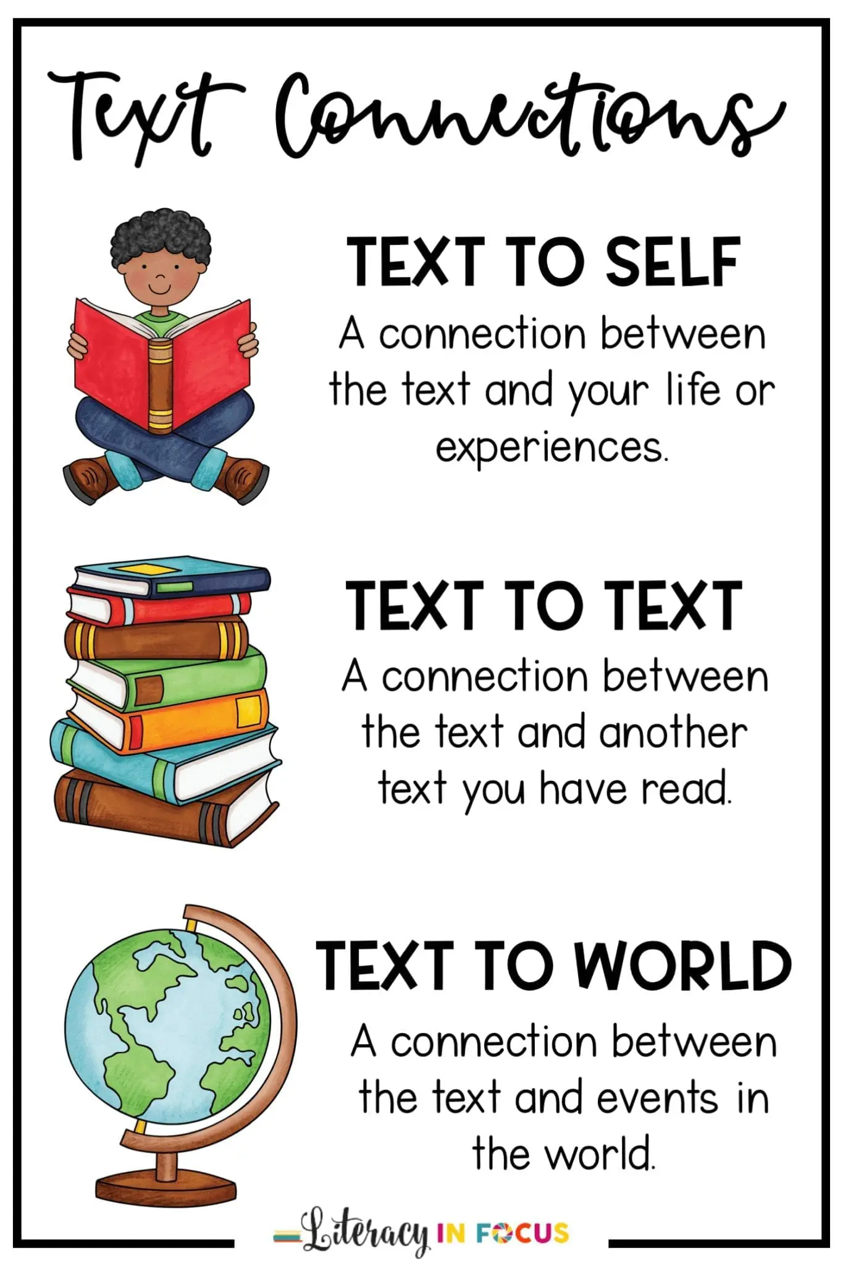
4. Critical readers actively refer to other texts, related to the topic of their investigation
Active readers look for connections between texts
Critical readers and researchers understand that it is not enough to look at a research question from a narrow perspective
Active readers and researchers will always expand their local investigative contexts by seeking out related texts and other sources which would definitely broaden their understanding and study, allowing them to see the bigger picture

Slide 13
Conclusion
Reading and writing are rhetorical processes which depend on each other. A good writer must engage the readers into a dialogue presented in the writing, similarly the goal of a critical and active reader is to participate in that dialogue and say something back to the writer and other readers too
Our ideas are formed and shaped by our interaction with others Both reading and writing allows for discussion on complex and difficult issues with others – to persuade and be persuaded and most importantly, to act
The key to becoming an active, critical and interested reader is the development of varied and effective reading techniques and strategies
Overall, reading is a dynamic skill that evolves as individuals develop their understanding of language, text, and ideas. It’s essential for success in education, personal growth, and active participation in society
“ Being able to read critically is important no matter what you plan on doing with your career or life because it allows you to understand the world around you”
Alex Cimino-Hurt

Slide 14
Bibliography
“Research and Critical Reading” by Pavel Zemilansky (from Oregon Writes Open Writing Text by Jennifer Kepka 2016)
“Introduction” by David Bartholomae and Anthony Petrosky (from Ways of Reading by David Bartholomae et al eds., 2008)

